Slide 1

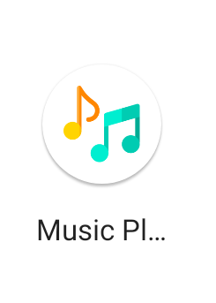
Chandigarh University
RIDHIM
Presented by
S SUPERVISOR
Sujata Singh (20BCS7295)
Gurwinder Singh(20BCS7634)
Pushpinder Singh (20BCS7300)
Parvez Rahi (E14563)
Computer Science & Engineering
MAY- 2023

Slide 2
Content
Abstract
Introduction
Theory and fundamentals
Objectives
Literature review
Methodology
Tools and technologies
Data collection / Data analysis
Findings and results
Applications
Conclusion
Future scope
References
RIDHIM
MAY- 2023
2

Slide 3
1. Abstract
This project is about developing a Music Player Android App that provides users with a user-friendly interface, advanced features, and customization options to enhance their music listening experience. The app includes features such as playlists, equalizer, gapless playback, replay, and customizable user modes. The app's design is focused on simplicity, while its advanced features and customization options provide users with a highly personalized experience. The Music Player Android App is an excellent choice for music lovers who are looking for a high-quality music player for their Android devices.
RIDHIM
MAY - 2023
3

Slide 4
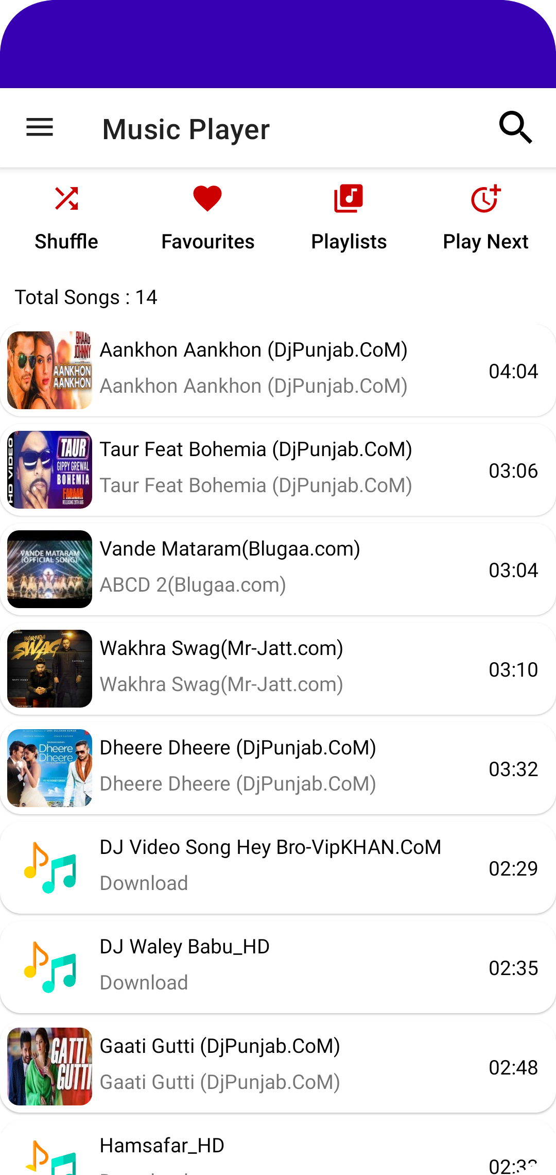
2. Introduction
The RIDHIM Music Player Application is an Android-based mobile application designed to provide users with a seamless and enjoyable listening experience. This project aims to develop a music player app that offers a range of features and functionalities, including audio playback, playlist management, cloud storage, real-time updates, and personalized recommendations.
The app is designed using Kotlin as the primary programming language and XML for designing the user interface. Firebase is used as the backend infrastructure for storing user data, providing real-time updates, and enabling cloud storage. By leveraging modern technologies and best practices, this project aims to deliver a music player app that is both user-friendly and feature-rich.
RIDHIM
MAY - 2023
4

Slide 5

3. Theory and fundamentals
Firebase Authentication: Firebase Authentication provides an easy way to authenticate users in an Android app using various authentication providers such as email and password, Google, Facebook, and Twitter. Firebase Authentication can be integrated using Kotlin and XML, allowing users to sign in and access personalized content in an Android app.
Gradle build system: Gradle is a build system that is used to automate the building, testing, and deployment of Android apps. Gradle can be used to manage dependencies, build configurations, and generate app releases. It can be implemented using Kotlin and XML, allowing for efficient and automated app builds.
RIDHIM
MAY - 2023
5

Slide 6
4. Objectives
The main objective is to create application-based music player that enables users to stream their preferred music. The music player should have an intuitive interface that makes it simple for users to explore, search, and play music tracks. It should also be quick and easy to use.
RIDHIM
MAY - 2023
6

Slide 7
5. Literature review
Sr. No. | Author | Title | Source | Findings/Remark
1 | J.M. Lammers et al | Music Streaming Services: A Review | Journal /Publication | examines the technical aspects of music streaming services
2 | A. Montagnani and E. Losavio | The Impact of Music Streaming on the Music Industry: A Global Perspective | Journal /Publication | explores the economic and legal implications of music streaming for the music industry
3 | M. Ma and L. Yang | "Designing the User Experience of Music Streaming Apps: A Literature Review | Journal /Publication | reviews existing research on user experience design for music streaming apps
RIDHIM
MAY - 2023
7

Slide 8
6. Methodology
The methodology for developing a music player can be broken down into several steps:
Technology selection: The technology stack that will be used for the music player is selected in this step. This includes selecting the programming language, libraries, and frameworks that will be used to build the app. Some popular choices for building music players include Java, Kotlin, Android SDK, and SQLite.
User interface design: The user interface of the music player is designed in this step. The user interface should be intuitive and easy to use, with clear and concise navigation. Design considerations should include the use of colors, typography, and visual cues to enhance the user experience.
RIDHIM
MAY - 2023
8

Slide 9
7. Tools and technologies
Android Studio: Android Studio is an integrated development environment (IDE) for Android app development. It provides a rich set of tools for designing, coding, testing, and debugging Android apps.
Firebase: Firebase is a mobile and web application development platform that provides a range of backend services, such as authentication, real-time database, cloud messaging, and storage. Firebase can be integrated into an Android app to provide a robust backend infrastructure.
Kotlin: Kotlin is a modern programming language for the JVM and Android that is designed to be concise, expressive, and safe. Kotlin can be used to write Android apps that are more readable and maintainable than Java.
XML: XML is a markup language that is used for building user interfaces in Android apps. XML provides a flexible and declarative way of defining the layout and appearance of an Android app.
RIDHIM
MAY - 2023
9

Slide 10
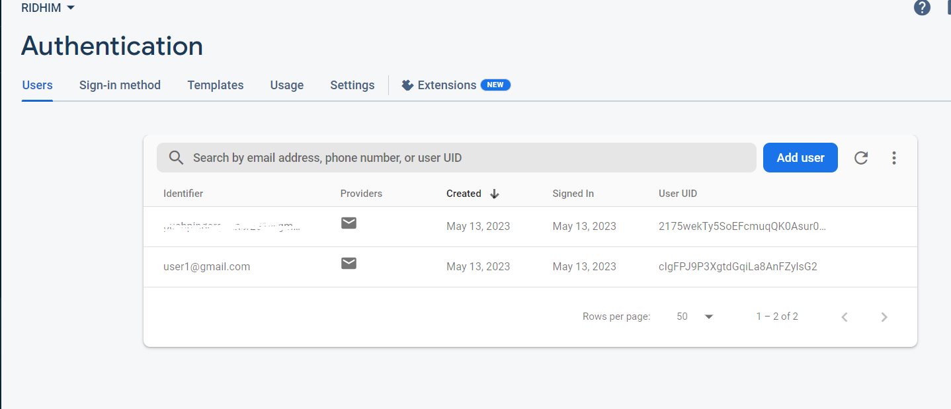
8. Data collection / Data analysis
Data like email or password credentials get collected in the Firebase Database which stores data in encrypted form.
RIDHIM
MAY - 2023
10

Slide 11
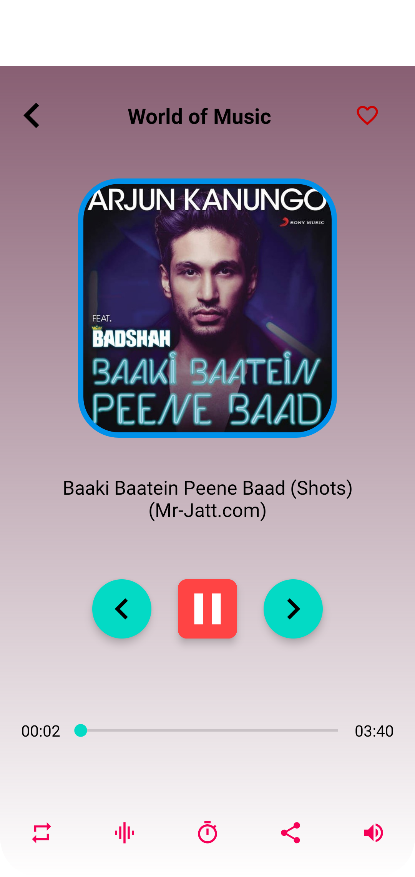
9. Findings and results
Improved user experience: A well-designed music player app can provide users with a seamless and intuitive listening experience, with features such as easy navigation, personalized playlists, and user-friendly controls.
Increased engagement and retention: By providing users with a range of features and functionalities, a music player app can increase user engagement and retention, leading to higher user ratings and reviews.
RIDHIM
MAY - 2023
11

Slide 12
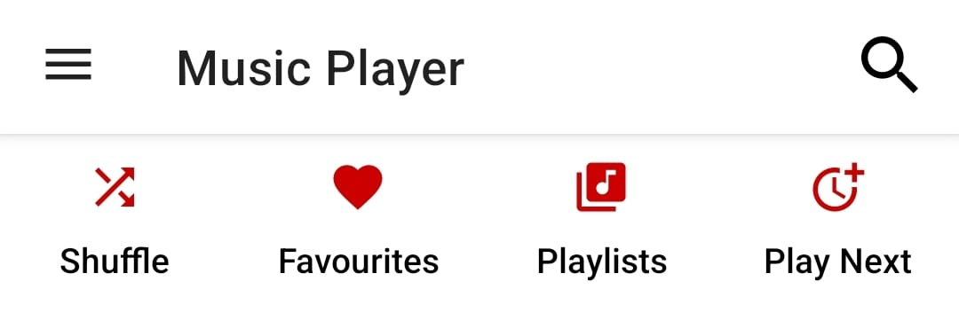
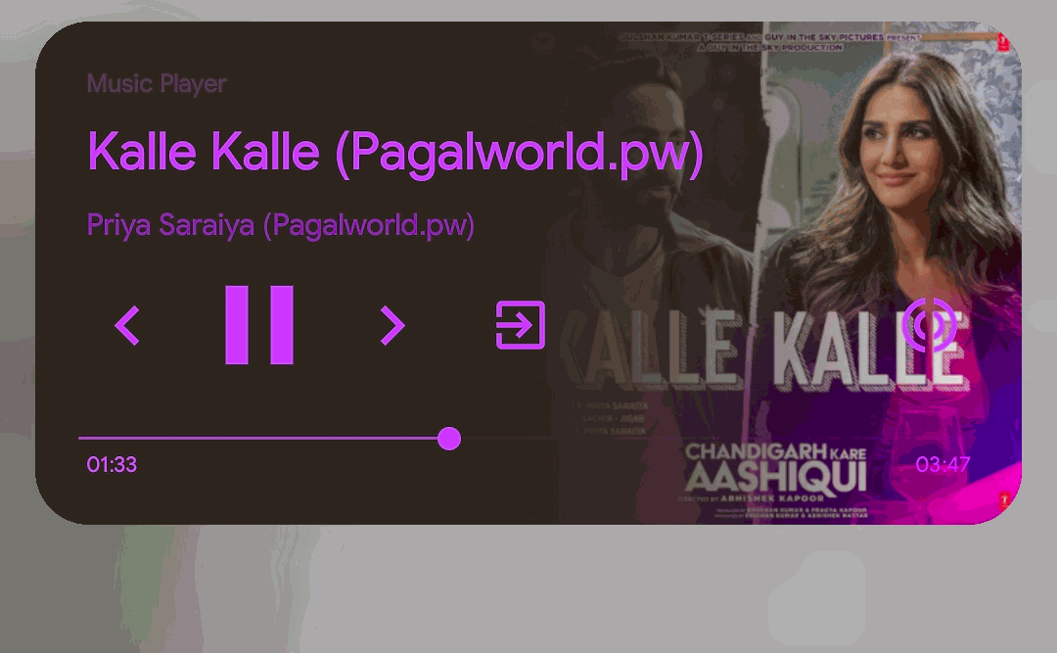
10. Applications
Play/Pause Audio Using Earphones
Play Next Feature (i.e. Now You Can Schedule Upcoming Songs)
Dark Theme(Using Black Theme in Settings)
Favourite Songs
Create & Add Playlists
Sleep Timer
Audio Booster
Built-in System Equalizer
Audio Booster or Audio Amplifier
Custom Themes Swipe to Refresh UI
Background Playing with Custom Notification
Android 10 Notification with Seekbar
RIDHIM
MAY - 2023
12

Slide 13
11. Conclusion
In conclusion, developing a music player Android app can be a challenging yet rewarding project that requires a combination of technical skills and creativity. With the use of Kotlin, XML, and Firebase, developers can build a feature-rich music player
Overall, a music player app can provide a useful tool for music enthusiasts and offer a unique platform for music sharing and discovery. By incorporating best practices and leveraging modern technologies, developers can create a music player app that stands out in a crowded market and delivers a satisfying experience to users.
RIDHIM
MAY - 2023
13

Slide 14
12. Future scope
Voice recognition and control: Adding voice recognition and control features to the music player app can provide users with a hands-free listening experience, allowing them to search for songs, skip tracks, and adjust volume using voice commands.
Social sharing and collaboration: Adding social sharing and collaboration features to the app can allow users to share their favorite songs and playlists with friends and connect with other music enthusiasts.
Machine learning and recommendation algorithms: Using machine learning and recommendation algorithms, the music player app can analyze users' listening habits and preferences to provide personalized recommendations for new songs and artists.
RIDHIM
MAY - 2023
14

Slide 15
13. References
1) The State of the Music Streaming Industry in 2021" by MIDiA Research: This report provides an overview of the music streaming market, including key players, trends, and challenges.
2) "Music Streaming Services: A Review" by J.M. Lammers et al.: This academic article examines the technical aspects of music streaming services, including audio quality, codec formats, and metadata.
3) "The Impact of Music Streaming on the Music Industry: A Global Perspective" by A. Montagnani and E. Losavio: This academic article explores the economic and legal implications of music streaming for the music industry, including revenue models and copyright issues.
RIDHIM
MAY - 2023
15

Slide 16


